Slide 1
Able to Create Styles of web pages using CSS
(25 hours)
Notes:
Title - The learning outcome
Subtitle - Duration

Slide 2
In this section, we will discuss:
Introduction to CSS
Limitations of CSS
Advantages of CSS
CSS Syntax
Three ways to integrate CSS
Merits and demerits of -external Style Sheets,, Embedded Style Sheets
Notes:
Mention the parent topics one by one. This particular learning outcome has 6 parent topics.

Slide 3
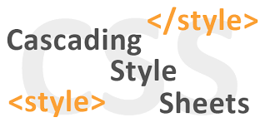
Introduction to CSS
CSS
CSS stands for Cascading Style Sheets.
It is the language for describing the presentation of Web pages, including colours, layout, and fonts, thus making our web pages presentable to the users.
Image Source:
https://encryptedbn0.gstatic.com/images?q=tbn:ANd9GcRrQ6UjtIs5YsI5AKDLxCDPh0KQP10DgI9Tnw&usqp=CAU
Notes:
Left (White Color space):
Title - Parent Topic
Subtitle - Subtopic 1
Body Text - Description in bullets
Right (Grey Color Space):
Body Text - Relevant image (with source)/code snippet
Cascading Style Sheets is a style sheet language used for describing the presentation of a document written in a markup language such as HTML.
Reference:
https://encryptedbn0.gstatic.com/images?q=tbn:ANd9GcRrQ6UjtIs5YsI5AKDLxCDPh0KQP10DgI9Tnw&usqp=CAU

Slide 4
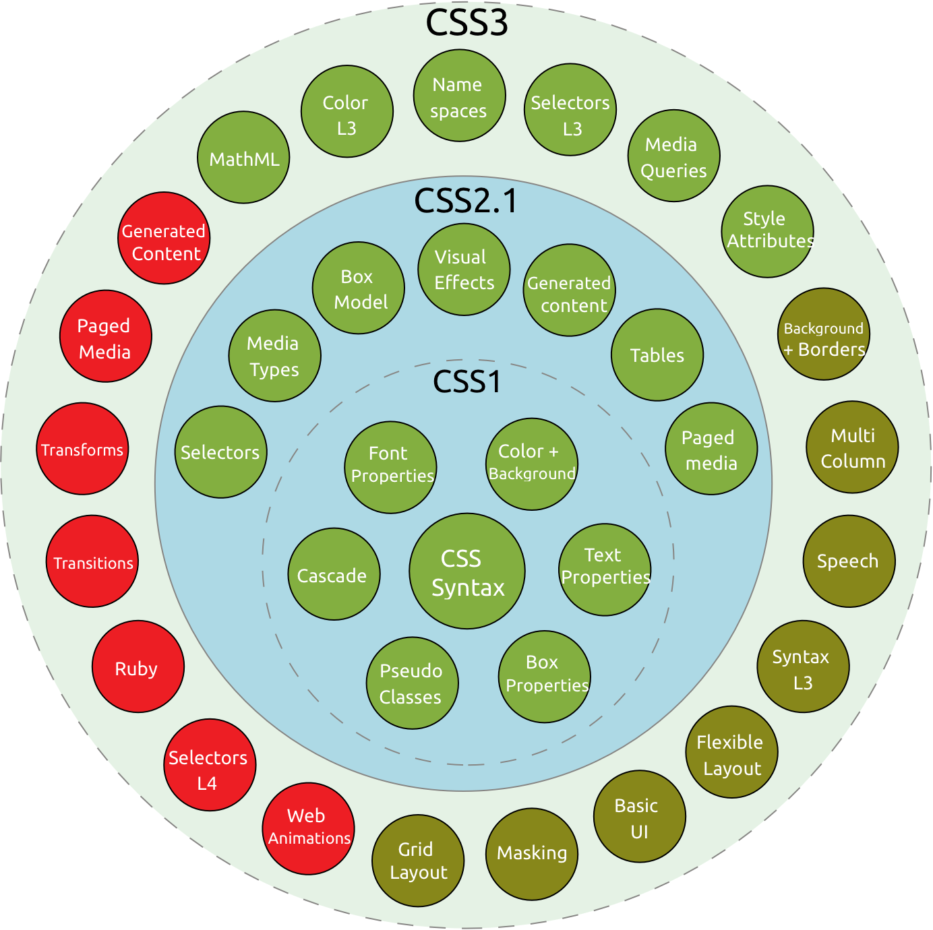
Introduction to CSS
History of CSS
CSS was first proposed by Hakon Wium Lie on October 10, 1994
CSS was proposed in 1994 as a web styling language, to solve some of the problems of Html 4
Image Source::
https://miro.medium.com/max/2768/1*7V_zawxy3_kZbHs2d6NT9w.png
Notes:
This slide talks about the case if we have to divide a subtopic further.
Left (White Color space):
Title - Parent Topic
Subtitle - Subtopic 2
Body Text - Description in bullets
Right (Grey Color Space):
Body Text - Relevant image (with source)/code snippet
CSS (1996) allows the user to select font style and size and change the colour of the text and background.
CSS2 (1998) has capabilities that allows the user to design page layout.
CSS3 (1999) allows the user to create presentations from documents and to select from a wider range of fonts including those from Google and Typecast. Uniquely, CSS3 allows the user to incorporate rounded borders and use multiple columns. CSS3 is considered to be easier to use (when compared to CSS2) because it has different modules
Reference:
https://miro.medium.com/max/2768/1*7V_zawxy3_kZbHs2d6NT9w.png

Slide 5
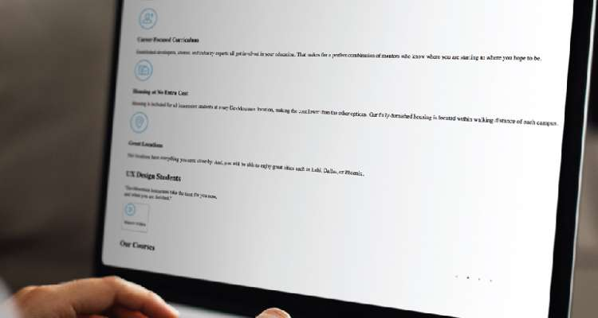

Introduction to CSS
Why CSS?
CSS saves time
Easy Maintenance
Search Engines
Superior styles to HTML
Offline Browsing
Image Source:
https://blog.devmountain.com/what-is-css-and-why-use-it/
Notes:
Left (White Color space):
Title - Parent Topic
Subtitle - Subtopic 3
Body Text - Description in bullets
Right (Grey Color Space):
Body Text - Relevant image (with source)/code snippet
CSS saves time : You can write CSS once and reuse same sheet in multiple HTML pages.
Easy Maintenance : To make a global change simply change the style, and all elements in all the webpages will be updated automatically.
Search Engines : CSS is considered as clean coding technique, which means search engines won’t have to struggle to “read” its content.
Superior styles to HTML : CSS has a much wider array of attributes than HTML, so you can give a far better look to your HTML page in comparison to HTML attributes.
Offline Browsing : CSS can store web applications locally with the help of offline cache. Using of this we can view offline websites.
Reference:
https://blog.devmountain.com/what-is-css-and-why-use-it/

Slide 6
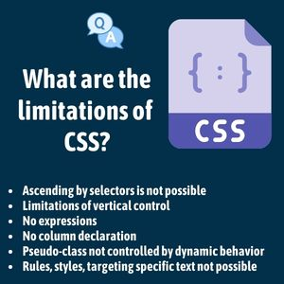
Limitations of CSS
Limitations
Confusion due to many CSS Versions
Cross-Browser Issues
Security Issues
Extra Work for Developers
Image Source:
https://i0.wp.com/www.mocamboo.com/wpcontent/uploads/2021/10/163342618048plc.jpg?fit=300%2C300&ssl=1
Notes:
Left (White Color space):
Title - Parent Topic
Body Text – Subtopic
Body Text - Description in bullets
Right (Grey Color Space):
Body Text - Relevant image (with source)/code snippet
CSS cannot perform any logical operations like if/else or for/while or +/-.
We can not read any files using CSS.
It can not interact with databases.
CSS can not request a web page.
Reference:
https://i0.wp.com/www.mocamboo.com/wpcontent/uploads/2021/10/163342618048plc.jpg?fit=300%2C300&ssl=1

Slide 7
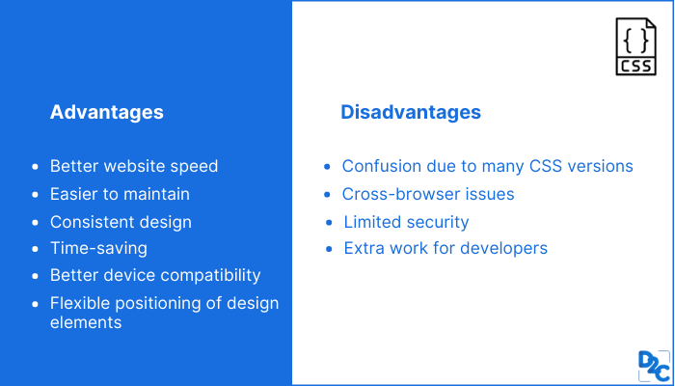
Advantages of CSS
Advantages
CSS saves time
Pages load faster
Superior styles to HTML
Multiple Device Compatibility
Global web standards
Offline Browsing
Platform Independence
Image Source:
https://d8it4huxumps7.cloudfront.net/bites/wp-content/banners/2021/10/616ffee11ce1e_advantages_and_disadvantages_of_css.png
Notes:
Left (White Color space):
Title - Parent Topic
Body Text – Subtopic
Body Text - Description in bullets
Right (Grey Color Space):
Body Text - Relevant image (with source)/code snippet
CSS saves a lot of time.
It helps to make consistent and spontaneous changes.
It improves the loading speed of the page.
CSS has the ability to re-position.
It has better device compatibility.
Reference:
https://d8it4huxumps7.cloudfront.net/bites/wp-content/banners/2021/10/616ffee11ce1e_advantages_and_disadvantages_of_css.png

Slide 8
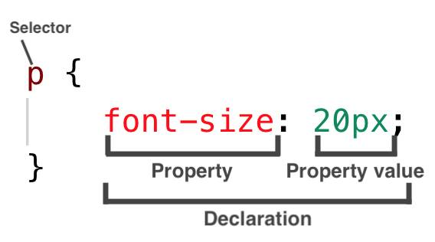
CSS Syntax
Syntax
3 Elements to a CSS Statement
Selector
Property
Value
Image Source:
https://codebrainer.azureedge.net/images/what-is-css-declaration.jpg
Notes:
Left (White Color space):
Title - Parent Topic
Body Text – Subtopic 1
Body Text - Description in bullets
Right (Grey Color Space):
Body Text - Relevant image (with source)/code snippet
Selector: selects the element you want to target
Keys: properties(attributes) like color, font-size, background, width, height, etc
Value: values associated with these properties
There are few basic selectors like tags, id’s, and classes
All forms this key-value pair
Reference:
https://codebrainer.azureedge.net/images/what-is-css-declaration.jpg

Slide 9
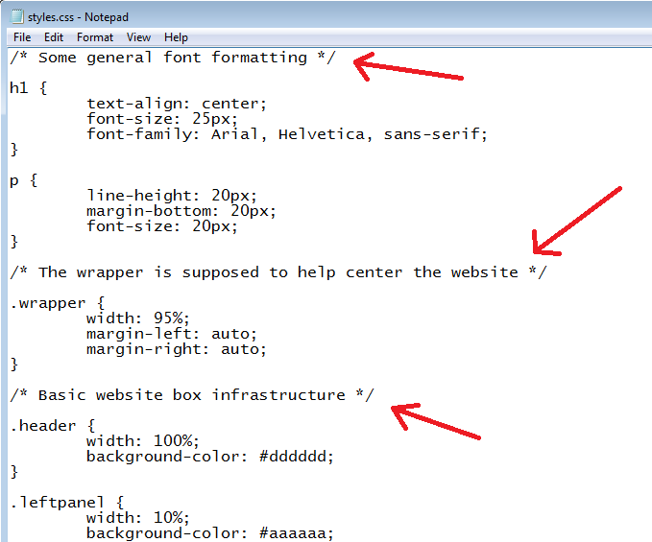
CSS Syntax
CSS Comments
Comments are used to explain the code, and may help when you edit the source code at a later date.​
Comments are ignored by browsers.
Image Source:
https://www.freezenet.ca/wp-content/uploads/2019/03/CSS_9_1.png
Notes:
This slide talks about the case if we have to divide a subtopic further.
Left (White Color space):
Title - Parent Topic
Subtitle - Subtopic 2
Body Text - Description in bullets
Right (Grey Color Space):
Body Text - Relevant image (with source)/code snippet
A CSS comment is used to add explanatory notes to the code or to prevent the browser from interpreting specific parts of the style sheet. By design, comments have no effect on the layout of a document
Reference:
https://www.freezenet.ca/wp-content/uploads/2019/03/CSS_9_1.png

Slide 10

CSS Syntax
White Spaces in CSS
White spaces are special characters that can be an actual space, tab, or newline (carriage return).
These whitespaces are used to construct your stylesheets extra readable.
Image Source:
https://i0.wp.com/css-tricks.com/wp-content/uploads/2011/09/pre.png?resize=290%2C97
Notes:
Left (White Color space):
Title - Parent Topic
Subtitle - Subtopic 3
Body Text - Description in bullets
Right (Grey Color Space):
Body Text - Relevant image (with source)/code snippet
white-space is a CSS property that helps control how whitespace and line breaks within an element's text are treated
Reference:
https://i0.wp.com/css-tricks.com/wp-content/uploads/2011/09/pre.png?resize=290%2C97

Slide 11
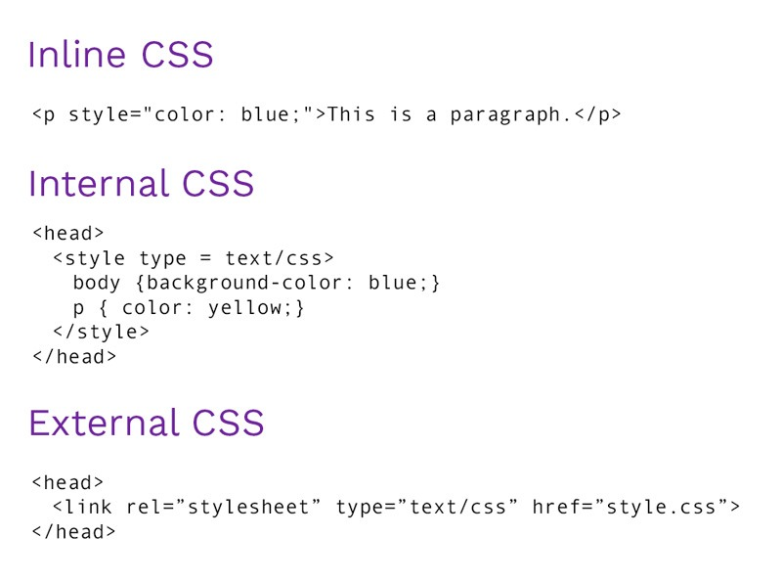
Three ways to integrate CSS
Types of CSS
Inline style sheet
Internal style sheet
External style sheet
Image Source:
https://www.bitdegree.org/learn/inline-css
Notes:
Left (White Color space):
Title - Parent Topic
Body Text – Subtopic 1
Body Text - Description in bullets
Right (Grey Color Space):
Body Text - Relevant image (with source)/code snippet
Internal - Placed right on the page whose interface it will affect.
External - Placed in a separate file.
Inline - Placed inside a tag it will affect.
Reference:
https://www.bitdegree.org/learn/inline-css

Slide 12
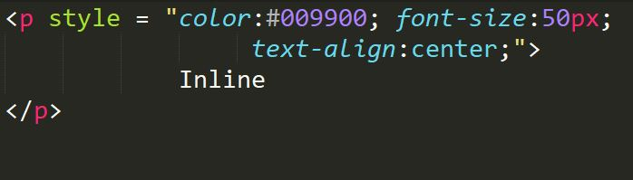
Types of CSS
Inline Style
Inline styles are placed within an HTML element in the code.
Inline styles do not have selectors because its written inside the html element.
Notes:
This slide talks about the case if we have to divide a subtopic further.
Left (White Color space):
Title - Parent Topic
Body Text – Subtopic of Subtopic
Body Text - Description in bullets
Right (Grey Color Space):
Body Text - Relevant image (with source)/code snippet
Inline Styles Sheet
Inline CSS is use with any elements of HTML where it is used on page. Here we use inline css for paragraph,
<p style="color:sienna;margin-left:20px">This is a paragraph.</p>
Reference:

Slide 13
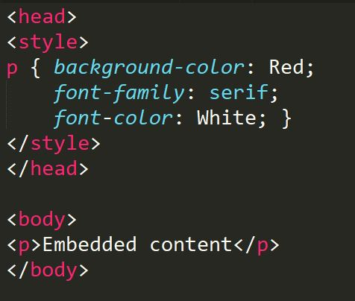
Types of CSS
Internal Style
An internal CSS is used to define a style for a single HTML page.
An internal CSS is defined in the <head> section of an HTML page, within a <style> element.
Notes:
Left (White Color space):
Title - Parent Topic
Body Text –Subtopic of Subtopic
Body Text - Description in bullets
Right (Grey Color Space):
Body Text - Relevant image (with source)/code snippet
Internal Style Sheet
An internal style sheet should be used when a single document has a unique style. Internal styles sheet is defined in the head section of an HTML page, by using the <style> tag
<style>
hr {
color:red;
}
p {
margin-left:20px;
}
</style>
Reference:

Slide 14
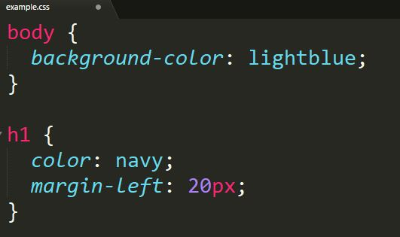
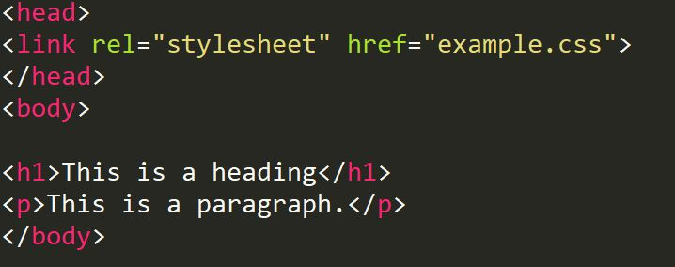
Types of CSS
External Style
External Styles can be reused to apply on more than one page by only linking the style sheet to the web page.
Notes:
Left (White Color space):
Title - Parent Topic
Body Text – Subtopic of Subtopic
Body Text - Description in bullets
Right (Grey Color Space):
Body Text - Relevant image (with source)/code snippet
An external style sheet is a separate CSS file that can be accessed by creating a link within the head section of the webpage.
Multiple webpages can use the same link to access the stylesheet.
The link to an external style sheet is placed within the head section of the page.
External Style Sheet
An external style sheet is ideal when the style is applied to many pages. With an external style sheet, we can change the look of an entire Web site by changing one file. Each page must link to the style sheet using the tag.
<head>
<link rel="stylesheet" type="text/css" href="name of the Css file">
</head>
p{
color:red; //.css file
}
Reference:

Slide 15
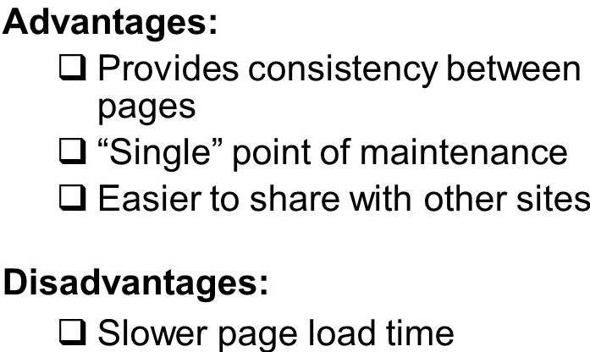
Merits and demerits of - external Style Sheets, Embedded Style Sheets
External Style Sheet
Merits
one change to the style sheet will change all linked pages
consistent look and feel across multiple web pages
Demerits
To render the document, the external style sheet should be loaded.
Image Source:
https://images.slideplayer.com/24/6963284/slides
Notes:
Left (White Color space):
Title - Parent Topic
Body Text – Subtopic 1
Body Text - Description in bullets
Right (Grey Color Space):
Body Text - Relevant image (with source)/code snippet
External Style Sheet
Merits
one change to the style sheet will change all linked pages
you can create classes of styles that can then be used on many different HTML elements
consistent look and feel across multiple web pages
Demerits
Extra download is needed to import documents having style information.
To render the document, the external style sheet should be loaded.
Reference:
https://images.slideplayer.com/24/6963284/slides

Slide 16
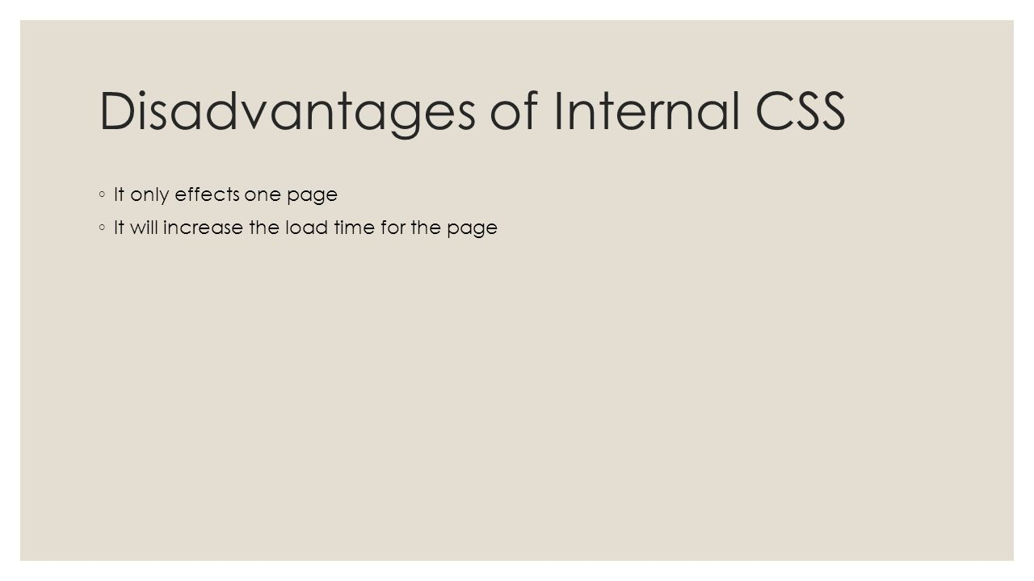
Merits and demerits of - external Style Sheets, Embedded Style Sheets
Embedded Style Sheets
Merits
Multiple tag types can be created in a single document.
Extra download is unnecessary.
Demerits
Multiple documents cannot be controlled.
Image Source:
https://images.slideplayer.com/24/6963284/slides
Notes:
Left (White Color space):
Title - Parent Topic
Body Text – Subtopic 2
Body Text - Description in bullets
Right (Grey Color Space):
Body Text - Relevant image (with source)/code snippet
Embedded/Internal Style Sheet
Merits
Multiple tag types can be created in a single document.
Styles, in complex situations, can be applied by using Selector and Grouping methods.
Extra download is unnecessary.
Demerits
Multiple documents cannot be controlled.
Reference:
https://images.slideplayer.com/24/6963284/slides

Slide 17
CSS Values and Units
Example :
h1 { font-size: 60px; } p { font-size: 25px; line-height: 50px; }
CSS has several different units for expressing a length. Many CSS properties take "length" values, such as width, margin, padding, font-size, etc.
Length is a number followed by a length unit, such as 10px, 2em, etc.
Notes:
Left (White Color space):
Title - Parent Topic
Body Text – Subtopic of Subtopic
Body Text - Description in bullets
Right (Grey Color Space):
Body Text - Relevant image (with source)/code snippet
CSS Units and Values
CSS has several different units for expressing a length. Many CSS properties take "length" values, such as width, margin, padding, font-size, etc.
Length is a number followed by a length unit, such as 10px, 2em, etc.
Example
Set different length values, using px (pixels):
h1 { font-size: 60px; } p { font-size: 25px; line-height: 50px; }
There are two types of length units:
absolute
relative

Slide 18
Absolute Lengths
Unit | Description
cm | centimeters
mm | millimeters
in | inches (1in = 96px = 2.54cm)
px * | pixels (1px = 1/96th of 1in)
pt | points (1pt = 1/72 of 1in)
pc | picas (1pc = 12 pt)
The absolute length units are fixed and a length expressed in any of these will appear as exactly that size.
Absolute length units are not recommended for use on screen, because screen sizes vary so much. However, they can be used if the output medium is known, such as for print layout.
Notes:
Left (White Color space):
Title - Parent Topic
Body Text – Subtopic of Subtopic
Body Text - Description in bullets
Right (Grey Color Space):
Body Text - Relevant image (with source)/code snippet
Absolute Lengths
The absolute length units are fixed and a length expressed in any of these will appear as exactly that size.
Absolute length units are not recommended for use on screen, because screen sizes vary so much. However, they can be used if the output medium is known, such as for print layout.
* Pixels (px) are relative to the viewing device. For low-dpi devices, 1px is one device pixel (dot) of the display. For printers and high-resolution screens 1px implies multiple device pixels.

Slide 19
Relative Lengths
Unit | Description
em | Relative to the font-size of the element (2em means 2 times the size of the current font)
ex | Relative to the x-height of the current font (rarely used)
ch | Relative to the width of the "0" (zero)
rem | Relative to font-size of the root element
vw | Relative to 1% of the width of the viewport*
vh | Relative to 1% of the height of the viewport*
vmin | Relative to 1% of viewport's* smaller dimension
vmax | Relative to 1% of viewport's* larger dimension
% | Relative to the parent element
Relative length units specify a length relative to another length property. Relative length units scale better between different rendering medium.
Notes:
Left (White Color space):
Title - Parent Topic
Body Text – Subtopic of Subtopic
Body Text - Description in bullets
Right (Grey Color Space):
Body Text - Relevant image (with source)/code snippet
Relative Lengths
Relative length units specify a length relative to another length property. Relative length units scale better between different rendering medium.

Slide 20
CSS Styling Text
Text Color
Text Color and Background Color
CSS Text Alignment and Text Direction
Text Alignment
Text Direction
Text Transformation
CSS Text Indentation,
Letter Spacing,
Line Height,
Word Spacing, and White Space
Text Shadow
Text Formatting
This text is styled with some of the text formatting properties. The heading uses the text-align, text-transform, and color properties. The paragraph is indented, aligned, and the space between characters is specified
Notes:
Left (White Color space):
Title - Parent Topic
Body Text – Subtopic 2
Body Text - Description in bullets
Right (Grey Color Space):
Body Text - Relevant image (with source)/code snippet
CSS Styling Text
CSS has a lot of properties for formatting text.
Text Formatting
This text is styled with some of the text formatting properties. The heading uses the text-align, text-transform, and color properties. The paragraph is indented, aligned, and the space between characters is specified.
Text Color
The color property is used to set the color of the text.
The color is specified by:
a color name - like "red"
a HEX value - like "#ff0000"
an RGB value - like "rgb(255,0,0)"
Look at CSS Color Values for a complete list of possible color values.
The default text color for a page is defined in the body selector.
Example
body { color: blue; } h1 { color: green; }
Text Color and Background Color
In this example, we define both the background-color property and the color property:
Example
body { background-color: lightgrey; color: blue; } h1 { background-color: black; color: white; } div { background-color: blue; color: white;}
The CSS Text Color Property
Property
Description
Specifies the color of text
CSS Text Alignment and Text Direction
In this chapter you will learn about the following properties:
text-align
text-align-last
direction
Unicode-bidi
vertical-align
Text Alignment
The text-align property is used to set the horizontal alignment of a text.
A text can be left or right aligned, centered, or justified.
The following example shows center aligned, and left and right aligned text (left alignment is default if text direction is left-to-right, and right alignment is default if text direction is right-to-left):
Example
h1 { text-align: center; } h2 { text-align: left; } h3 { text-align: right; }
When the text-align, property is set to "justify", each line is stretched so that every line has equal width, and the left and right margins are straight (like in magazines and newspapers):
Example
div { text-align: justify; }

Slide 21
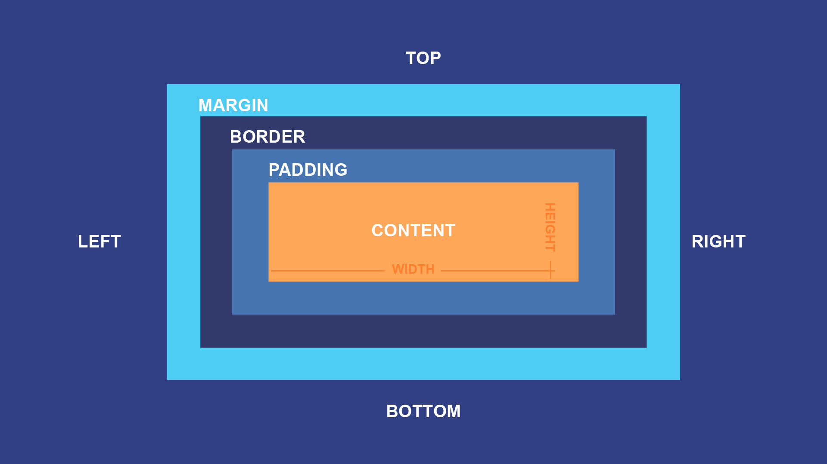
CSS Box Model
The CSS box model is essentially a box that wraps around every HTML element. It consists of: margins, borders, padding, and the actual content.
Notes:
Left (White Color space):
Title - Parent Topic
Body Text – Subtopic of Subtopic
Body Text - Description in bullets
Right (Grey Color Space):
Body Text - Relevant image (with source)/code snippet
CSS Box Model
In CSS, the term "box model" is used when talking about design and layout.
The CSS box model is essentially a box that wraps around every HTML element. It consists of: margins, borders, padding, and the actual content. The image below illustrates the box model:
Explanation of the different parts:
Content - The content of the box, where text and images appear
Padding - Clears an area around the content. The padding is transparent
Border - A border that goes around the padding and content
Margin - Clears an area outside the border. The margin is transparent

Slide 22
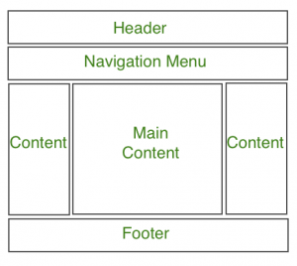
Website Layout
A website can be divided into various sections comprising of header, menus, content and footer based on which there are many different layout designs available for developer. Different layouts can be created by using div tag and use CSS property to style it.
Notes:
Left (White Color space):
Title - Parent Topic
Body Text – Subtopic of Subtopic
Body Text - Description in bullets
Right (Grey Color Space):
Body Text - Relevant image (with source)/code snippet
Website Layout
A website can be divided into various sections comprising of header, menus, content and footer based on which there are many different layout designs available for developer. Different layouts can be created by using div tag and use CSS property to style it. The most common structure of website layout is given below:
Notice: Header section contains a website logo, a search bar and profile of user. The navigation menu contains link to various categories of articles available and content section is divided into 3 parts(columns) with left and right sidebar containing links to other articles and advertisements whereas the main content section is the one containing this article, then at the bottom there is a footer section which contains address, links, contacts etc.
Header Section: The header section is generally placed either at the top of the Website or just below a top navigation menu. It often comprises of the name of the Website or the logo of the Website.
Navigation Menu: A Navigation Bar/Menu is basically a list of links that allows visitor to navigate through the website comfortably with easy access.
Content Section: The content section is the main body of the website.
The user can divide content section in n-column layout.
The most common layouts are:
1-Column Layout: It is mostly used for mobile layout.
2-Column Layout: This website layout is mostly used for tablets or laptops. 3-Column Layout: This website layout is mostly used for desktops.

